Slide 1
Fuzzy inference
The most commonly used fuzzy inference technique is the so-called Mamdani method.
In 1975, Professor Ebrahim Mamdani of London University built one of the first fuzzy systems to control a steam engine and boiler combination.
He applied a set of fuzzy rules supplied by experienced human operators.

Slide 2
Mamdani fuzzy inference
The Mamdani-style fuzzy inference process is performed in four steps:
fuzzification of the input variables
rule evaluation
aggregation of the rule outputs
defuzzification.

Slide 3











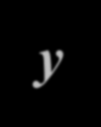















Example
We examine a simple two-input one-output problem that includes three rules:
Rule: 1 IF OR | x is A3 y is B1 | Rule: 1 IF OR | project_funding is adequate project_staffing is small
THEN | z is C1 | THEN risk is low
Rule: 2 |  | Rule: 2
IF | x is A2 | IF project_funding is marginal
AND | y is B2 | AND project_staffing is large
THEN | z is C2 | THEN risk is normal
Rule: 3 |  | Rule: 3
IF | x is A1 | IF project_funding is inadequate
THEN | z is C3 | THEN risk is high

Slide 4

Identify Linguistic Variables/Values and Inputs/Output
Rule: 1 IF OR | x is A3 y is B1 | Rule: 1 IF OR | project_funding is adequate project_staffing is small
THEN | z is C1 | THEN risk is low
Rule: 2 |  | Rule: 2
IF | x is A2 | IF project_funding is marginal
AND | y is B2 | AND project_staffing is large
THEN | z is C2 | THEN risk is normal
Rule: 3 |  | Rule: 3
IF | x is A1 | IF project_funding is inadequate
THEN | z is C3 | THEN risk is high
Notes:
x,y,z – linguistic variables

Slide 5
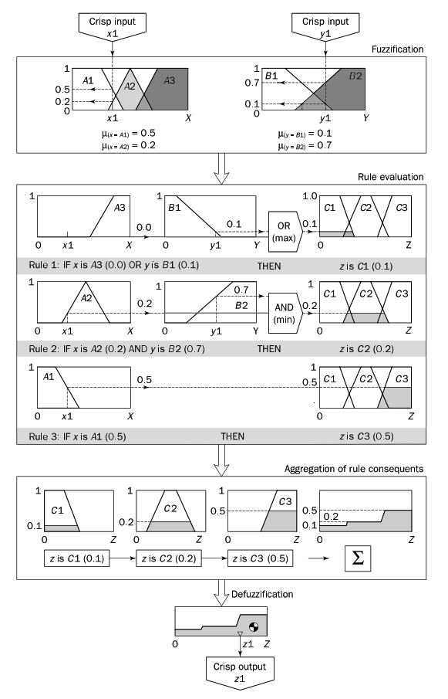
Mamdani-style fuzzy inference
5

Slide 6
Use hedges to generate new fuzzy sets if required.
Project funding (A)
={A1,A2,A3}
= {inadequate, marginal, adequate} Project staffing (B)
={B1, B2}
={small, large}
Risk (C) = { C1, C2, C3}
={low, normal, high}

Slide 7
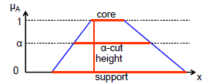
Fuzzy Membership Function
Membership function (MF) - A function that specifies the degree to which a given input belongs to a set.
Degree of membership- The output of a membership function, this value is always limited to between 0 and 1. Also known as a membership value or membership grade.
Membership functions are used in the fuzzification and defuzzification steps of a FLS (fuzzy
logic system), to map the non-fuzzy input values to fuzzy linguistic terms and vice versa
Support: elements having non-zero degree of membership.
Core: set with elements having degree of 1.
α-Cut: set of elements with degree >= α.
Height: maximum degree of membership.
The Fuzzy Logic Toolbox includes 9 built-in membership function types.
These 9 functions are, in turn, built from several basic functions:
  Piecewise linear functions.
  Gaussian distribution function.
  Sigmoid curve.
  Quadratic polynomial curves.
  Cubic polynomial curves.

Slide 8
Membership Function
There are several ways to assign values to fuzzy variables:
Intuition- Based on human experience.
eg., I feel 25°C is moderately warm, so I’ll assign it 0.6 membership in Warm set.
Inference - Using reasoning or geometric shapes to define membership. This is what Mamdani inference uses.
Rank ordering - Values are ranked and converted to membership.
Angular fuzzy sets, Neural networks, Genetic algorithm- More advanced, automatic ways to learn membership from data.
Notes:
A membership function assigns a value between 0 and 1 to show how much an element belongs to a fuzzy set.

Slide 9
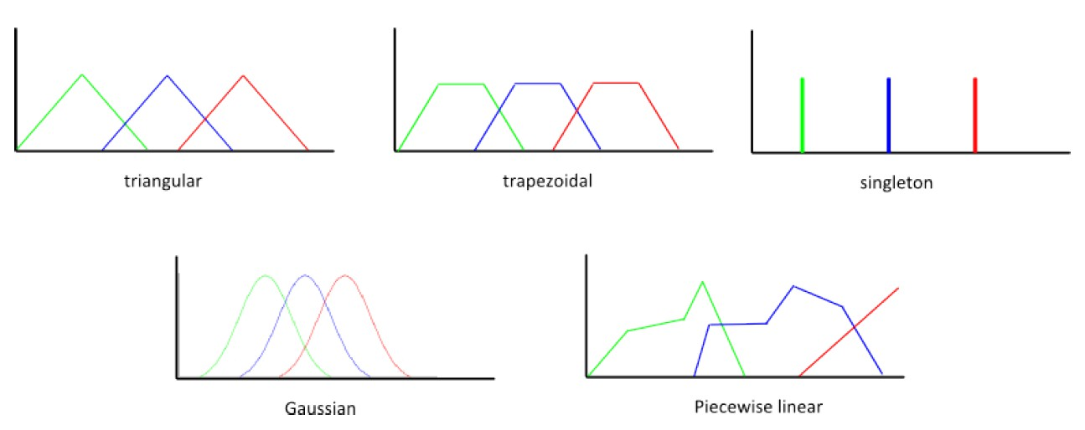
Membership Function
Membership functions may be defined by various shapes:
Triangular, Trapezoidal, Piecewise linear, Gaussian, Singleton.
Triangular MF – simplest, peak at maximum membership (1), slopes down linearly on both sides.

Slide 10
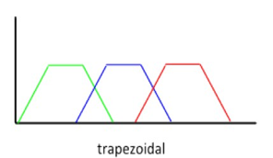
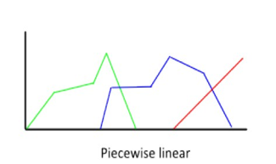
Membership Function
Trapezoidal MF - flat top at maximum membership, slopes at sides.
Piecewise linear MF – combination of line segments.

Slide 11
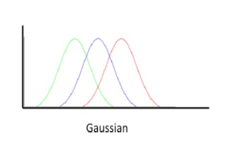
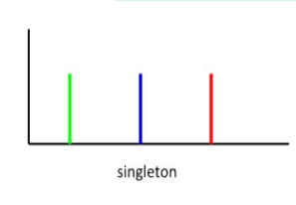
Membership Function
Gaussian MF – bell-shaped curve, smooth, often used when transitions are gradual.
Singleton MF – only one value has membership 1, useful in computation-heavy systems.
Shape choice depends on the problem and how we want to capture uncertainty.
Notes:
A singleton membership function is a fuzzy set where all input values have membership 0 except for a single point, which has membership 1.
Temperature is exactly 30°C

Slide 12
Membership Functions in the Fuzzy Logic Toolbox
The simplest membership functions are formed using straight lines.
These straight line membership functions have the advantage of simplicity.
  Triangular membership function: trimf.
  Trapezoidal membership function: trapmf.
Two membership functions are built on the Gaussian distribution curve: a simple Gaussian curve and a two-sided composite of two different Gaussian curves.
The two functions are gaussmf and gauss2mf.
The generalized bell membership function is specified by three parameters and
has the function name gbellmf.
Sigmoidal membership function: sigmf.
Polynomial based curves: Three related membership functions are the Z, S, and Pi curves, all named because of their shape ( The functions zmf, smf and pimf).
Fuzzy Logic Toolbox also allows you to create your own membership functions.
x = (0:0.1:10)'; y1 = trapmf (x, [2 3 7 9]); y2 = trapmf (x, [3 4 6 8]); y3 = trapmf
(x, [4 5 5 7]); y4 = trapmf (x, [5 6 4 6]);
plot (x, [y1 y2 y3 y4]);

Slide 13
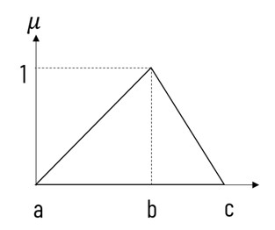
Triangular membership function
Most widely accepted and used membership function (MF).
The triangle which fuzzifies the input can be defined by three parameters a, b and c, where a and c defines the base and b defines the peak (the point where membership = 1). The height of the triangle is 1.
Trivial case:
If input x = b,
then it is having full membership
in the given set.
So, μ(x) = 1, if x = b
If input is less than a or greater then b, then it does belongs to
fuzzy set at all, and its membership value will be 0
μ(x)=0, x<a or x>c
Notes:
A triangular membership function is defined by three points: a,b,c on the x-axis.
a – where membership starts increasing from 0
b – the peak where membership = 1
c – where membership decreases back to 0

Slide 14
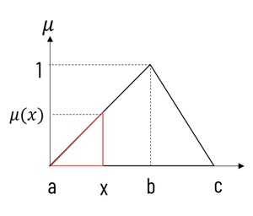
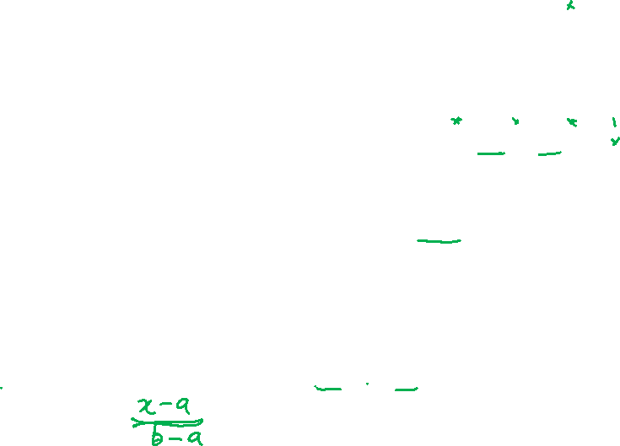
Triangular membership function
x is between a and b:
If x is between a and b, its membership value varies from 0 to 1.
If it is near a, its membership value is close to 0,
and if x is near to b, its membership value gets close to 1.
We can compute the fuzzy value of x using similar triangle rule, μ(x)= (x – a) / (b – a), a ≤ x ≤ b

Slide 15
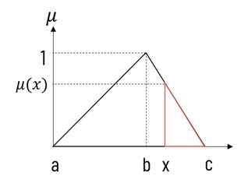
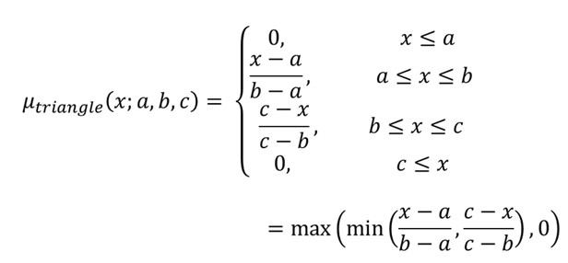
Triangular membership function
x is between b and c:
If x is between b and c, its membership value varies from 0 to 1.
If it is near b, its membership value
is close to 1, and if x is near to c,
its membership value gets close to 0.
We can compute the fuzzy value of x using similar triangle rule, μ(x) = (c – x) / (c – b), b ≤ x ≤ c
Combine all together:
The triangle rises from a to b and falls from b to c.
min picks the current height of the triangle at x.
max prevents negative membership.
Notes:
(x-a/b-a)​ → rising slope
(c-x/c-b) – falling slope
Membership values cannot be negative (they must be between 0 and 1).
So we use max(..., 0) to clip negative values to 0.

Slide 16
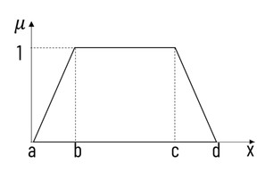
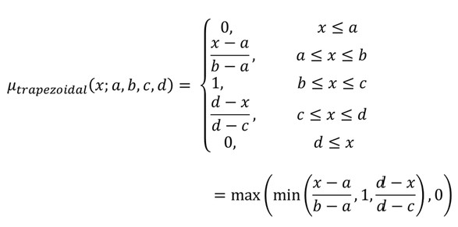

Trapezoidal membership function:
A trapezoidal membership function is defined by four parameters: a,b,c,d,
a - left foot of the trapezoid (membership = 0 starts)
b - left shoulder where membership reaches 1
c - right shoulder where membership starts to drop from 1
d - right foot where membership returns to 0
Notes:
Taking the min() of these three trims the top off the lines at height 1
max - to set a floor at zero and eliminate negative values.

Slide 17
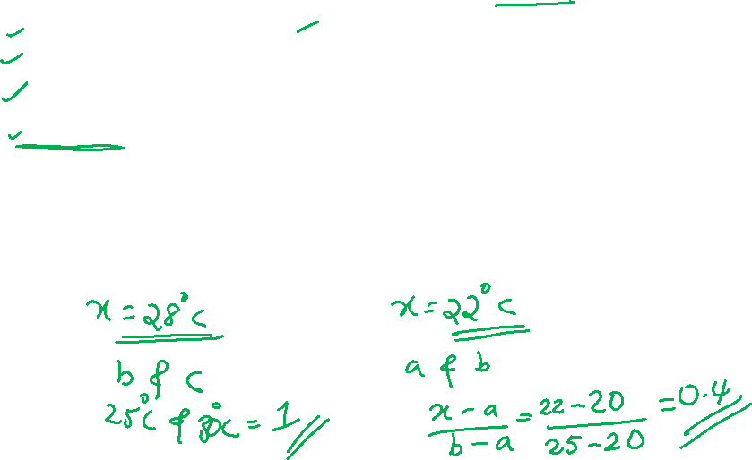
Example
Suppose we define Warm Temperature with TrMF:
  a = 20°C - starts rising
  b = 25°C - full membership 1
  c = 30°C - still full membership 1
  d = 35°C - membership drops back to 0
Membership of 28°C = 1 (inside flat top)
Membership of 22°C = (22-20)/(25-20) = 0.4

Slide 18
Step 1: Fuzzification
Examine risk involved in developing a fuzzy project
Expert provides x1 and y1
Given the crisp inputs, x1 and y1 (project funding
=35% and project staffing = 60%)
Determine the degree to which these inputs belong to each of the appropriate fuzzy sets.
Crisp Input x1
Crisp Input y1
1
0.5
0.2
0
1
0.7
0.1
0
A1
A2
A3
B1
B2
x1
^{μ}(x = A1) ^{= 0.5}
^{μ}(x = A2) ^{= 0.2}
X
y1
^{μ}(y = B1) ^{= 0.1}
^{μ}(y = B2) ^{= 0.7}
Y
Notes:
={A1,A2,A3} {inadequate, marginal, adequate}
={B1, B2} {small, large}

Slide 19
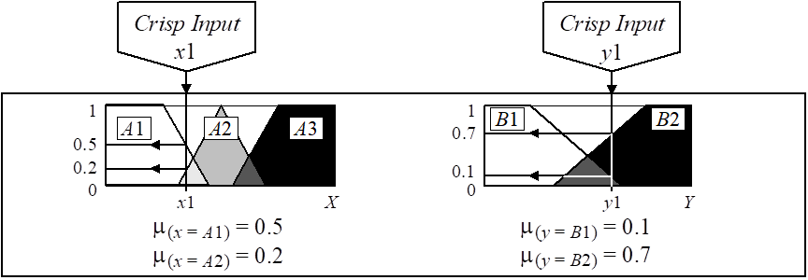
Step 1: Fuzzification
Given the crisp inputs, x1 and y1 (project funding =35% and project staffing = 60%)
A1 = {0,0,20,50}
A2 = {30, 50, 75}
B1 = {0,0,15,65}
B2 = {35,70,100,100}

Slide 20
Step 2: Rule Evaluation
Take the fuzzified inputs
μ(x=A1) = 0.5, μ (x=A2) = 0.2,
μ (y=B1) = 0.1 μ (y=B2) = 0.7
Apply them to the antecedents of the fuzzy rules.
This number (the truth value) is then applied to the consequent membership function.

Slide 21

Rule Evaluation (cont.)
To evaluate the disjunction of the rule antecedents, we use the OR fuzzy operation. Typically, fuzzy expert systems make use of the classical fuzzy operation union:
μ_{A}∪_{B}(x) = max [μ_{A}(x), μ_{B}(x)]
Similarly, in order to evaluate the conjunction of the rule antecedents, we apply the AND fuzzy operation intersection:
μ_{A}∩_{B}(x) = min [μ_{A}(x), μ_{B}(x)]

Slide 22

Mamdani-style rule evaluation
1 1 1 A3 B1 C1 C2 C3 _{0.0} 0.1 _{OR} 0.1 ⁰ x1 X ⁰ y1 Y ^{(max) 0} Z
Rule 1: IF x is A3 (0.0) OR y is B1 (0.1) THEN z is C1 (0.1)
¹ ¹ 0.7 ¹ A2 0.2 B2 _{AND} 0.2 ^{C1 C2 C3} (min) ⁰ x1 X ⁰ y1 Y ⁰ Z
Rule 2: IF x is A2 (0.2) AND y is B2 (0.7) THEN z is C2 (0.2)
1 1 A1 0.5 0.5 C1 C2 C3 ⁰ x1 X ⁰ Z
Rule 3: IF x is A1 (0.5) THEN z is C3 (0.5)
18
Notes:
z = C1 (Low risk), z = C2 (Normal risk), z = C3 (High risk)
clipping is done for simplicity and illustration purpose.

Slide 23
Rule Evaluation (cont.)
Antecedent evaluation gives us a firing strength(truth value)
For each rule, after evaluating the antecedent (AND/OR), we know how strongly the rule applies.
Eg: Rule 3 firing strength z = 0.5
This truth value must modify the consequent membership function
Consequent is a fuzzy set (triangle, trapezoid, etc.)
To reflect the influence of the rule, we adjust the output fuzzy set

Slide 24
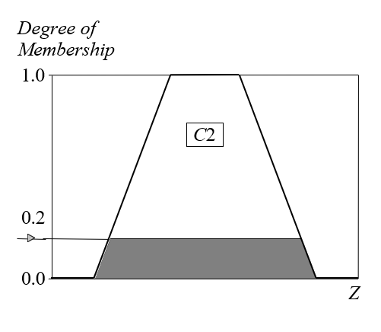
Rule Evaluation (cont.)
Now the result of the antecedent evaluation can be applied to the membership function of the consequent.
clipping : cut the consequent membership function at the level of the antecedent truth..
  Since the top of the membership function is sliced, the clipped fuzzy set loses some information.
Clipped membership functions

Slide 25
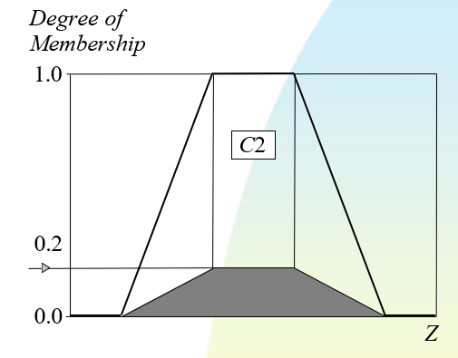
Rule Evaluation (cont.)
scaling : The original membership function of the rule consequent is adjusted by multiplying all its membership degrees by the truth value of the rule antecedent.
  offers a better approach for preserving the original shape of the fuzzy set.
  Generally loses less information
Scaling is like shrinking it while keeping the shape.
Scaled membership functions

Slide 26
Clipped and scaled membership functions
Degree of Membership
Degree of Membership
1.0
1.0
C2
C2
0.2
0.2
0.0
0.0
Z
Z
Clipped and scaled membership functions

Slide 27



Step 3: Aggregation of the rule outputs
Process of unification of the outputs of all rules.
take the membership functions of all rule consequents previously clipped or scaled and combine them into a single fuzzy set.
Input: the list of clipped or scaled consequent membership functions
Output: single fuzzy set for the overall fuzzy output.
1 1
1
0.5
C1
C2
C3
0.5 _{0.2}
0.1
Z 0
0.2
0
0.1
0
Z
Z
0
Z
z is C1 (0.1)
z is C2 (0.2)
z is C3 (0.5)
∑

Slide 28
Step 4: Defuzzification
Fuzziness helps us to evaluate the rules, but the final output of a fuzzy system has to be a crisp number.
The input for the defuzzification process is the aggregate output fuzzy set and the output is a single number.
There are several defuzzification methods
The most popular one is the centroid technique. It finds the point where a vertical line would slice the aggregate set into two equal masses.

Slide 29
Defuzzification (cont.)
Mathematically this centre of gravity (COG) can be
expressed as:
b
∫μ _{A} ( )
x xdx
COG = ª
b
∫μ _{A} (x) dx
a
Centroid defuzzification method finds a point
representing the centre of gravity of the fuzzy set, A, on the interval [a,b].
A reasonable estimate can be obtained by calculating it over a sample of points.
Notes:
Numerator- This is the moment of the area. It weights each position 𝑥 along the horizontal axis by how tall the curve is (𝜇𝐴 (𝑥) at that exact spot.
Denominator - This is simply the total area under the fuzzy curve.

Slide 30

Centre of gravity (COG)
_{COG =} (0 +10 + 20) × 0.1+ (30 + 40 + 50 + 60) × 0.2 + (70 + 80 + 90 +100) × 0.5 _{= 67.4}
0.1+ 0.1+ 0.1+ 0.2 + 0.2 + 0.2 + 0.2 + 0.5 + 0.5 + 0.5 + 0.5
Degree of Membership
1.0
0.8
0.6
0.4
0.2
0.0
0
10 20 30 40 50 60 70 80 90 100
Z
67.4
24
Notes:
Numerator- This is the moment of the area. It weights each position 𝑥 along the horizontal axis by how tall the curve is (𝜇𝐴 (𝑥) at that exact spot.
Denominator - This is simply the total area under the fuzzy curve.

